Slide 1
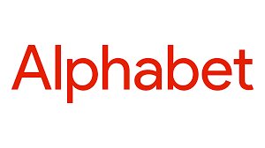

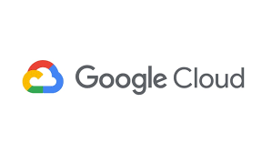

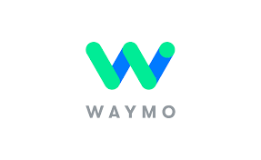

Equity Research on Alphabet Inc. (GOOG)
Company Name: Alphabet Inc.
Ticker: GOOG
Exchange: NASDAQ
Sector: Communication Service
Industry: Interactive Media & Services
Business Segment: Google Service, Google Cloud, Others (inc. Waymo, X, Verily, etc.)
Equity Research Report
Prepared by: Siddhant Bhardwaj
Date: 9/5/2025

Slide 2





Investment Thesis: Buy/Hold
Alphabet is well-positioned to deliver sustainable growth, supported by its leadership in generative AI through Gemini, resilient digital ad dominance, rapid monetization of YouTube Shorts, and Google Cloud’s improving profitability.
Valuation Summary:
Key Growth Drivers:
Current Price: $212.91
Target Price: $235.44
Upside: 10.58%
AI Leadership
Deep integration of Gemini across Search, Workspace, and Google Cloud is accelerating enterprise adoption, positioning Alphabet as a leader in applied AI.
YouTube
Monetization
Shorts engagement, creator monetization tools, and improving ad targeting are fueling revenue growth, with connected TV becoming a major driver
Cloud
Expansion
Google Cloud Platform is gaining share with rising operating margins, expanding enterprise deals, and differentiating through AI/ML workloads versus AWS and Azure.

Slide 3
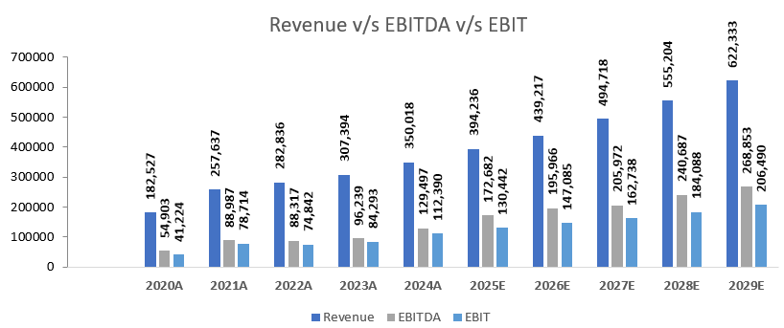
Company Overview
As the parent Company of Google, YouTube, and Waymo, Alphabet commands unmatched scale in digital advertising and video, while Google Cloud is becoming a key growth engine. Ongoing investments in artificial intelligence, cloud infrastructure, and Other Bets create multiple long-term optionality for shareholders.
Financials of 2024:
Market Cap: $2,323,530
Revenue: $350,018
EBITDA Margin: 36%
EBIT Margin: 32%
Net Income: $100,118
Business Segment:
Google Services: ~87% of total Revenue
Google Cloud: ~12% of total Revenue
Other Bets (Waymo, X, Verily, etc.): <1% of total Revenue

Slide 4




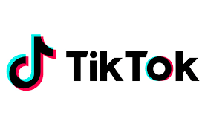
Industry and Competitive Landscape
Alphabet operates at the intersection of three massive markets—digital advertising, cloud computing, and artificial intelligence—competing with large-cap tech peers while maintaining a leadership position in ads and video.
Market Opportunity Sizing:
Market Opportunity Sizing:
Global Digital Advertising (2024–25): ~$1.04T in 2024; ~ $1.10T expected in 2025 (GroupM / industry forecasts).
Public Cloud (end-user spend): Gartner forecast — ~$596B in 2024, $723B in 2025 (public cloud services spending).
Artificial Intelligence (broad AI market): (2024-2025) ~ 283B Markets estimates the global AI market at ~$372B in 2025 with multi-year high growth; generative-AI software sub-segments show even faster expansion.
Microsoft (MSFT): Leader in cloud (Azure) + strategic AI (OpenAI partnership).
Meta (META): Video & social ad competitor; strong ad monetization & Reels competition.
Amazon (AMZN): Ads & leader in cloud infra (AWS).
Apple (AAPL): Device & on-device AI (privacy/AI integration).
TikTok (ByteDance): Short-form video — mass engagement, rising ad reach vs. YouTube Shorts.

Slide 5
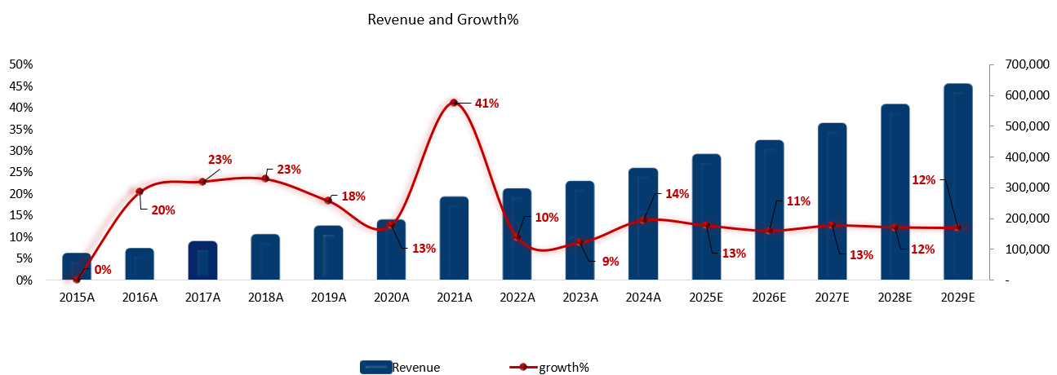
Financial Overview
Alphabet has delivered consistent double-digit revenue growth, strong operating margins, and robust free cash flow over the past 5 years, supported by its resilient ad business, cloud scale-up, and disciplined capital allocation.
Key Financial Metrics:
Key Financial Metric:
5-Year Revenue CAGR: ~17% (2019-2024)
Free Cash Flow (2024): $63,875
Roe (LTM): ~35%
ROIC (LTM): ~30%
P/E (LTM): ~26x
EV/EBITDA (LTM): ~20x
EV/Revenue: ~8x
Forecast Period: 2025-2029
MM($)

Slide 6
Valuation
Discounted Cash Flow Valuation (DCF)
Valuation Assumption:
WACC: 8.05%
Terminal Growth Rate: 2.5%
Forecast Period: 2025-2029
Terminal Method: Perpetuity Growth
Valuation Assumption (MM$):
11%
Terminal Value: 3,250,842
PV of Terminal Value: 2,416,064
Enterprise Value: 2,864,771
Equity Value: 2,928,360
Current Market Price: $212.91
Implied Share Price: $225.01
Upside %: 10.58%

Slide 7
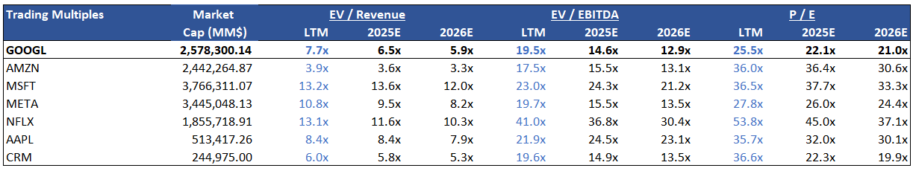







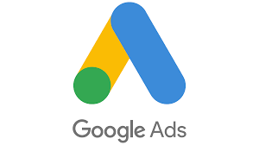


Valuation - Continued
Comparable Company Analysis:
GOOG: Leader in Ads + Cloud Growth
AMZN: AWS + Retail Scale
MSFT: Azure + AI Moat
META: Ads + Reels
NFLX: Streaming + Subscription
AAPL: Devices + Services
CRM: Cloud

Slide 8
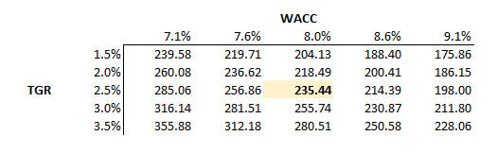
Valuation - Continued
Sensitivity Analysis:
Interpretation:
Base Case (8.09% WACC, 2.5% TGR): $235/share -> ~11% upside to CMP ($212.91).
Optimistic Case (7.59% WACC, 3.0% TGR): ~$287/share -> ~35% upside
Conservative Case (8.59% WACC, 2.0% TGR): ~$203/share -> ~ (4%) downside.
Takeaway: Even under conservative assumptions, Alphabet shows a limited downside of 4% and meaningful upside of 35%, supporting a Buy rating.

Slide 9
Catalysts
AI integration into Search (SGE / “AI Mode”) - new ad monetization slots:
Google is rolling its Search Generative Experience / AI Mode into results and testing paid “Sponsored” slots inside AI answers, preserving and expanding search ad monetization.
Gemini enterprise adoption & Workspace integration:
Gemini models are being embedded across Workspace (Docs, Sheets, Meet, Chat) and Google Cloud, increasing product stickiness and new revenue opportunities from both consumers and enterprises.
Cloud revenue acceleration and large backlog conversion:
Google Cloud surpassed a ~$50B annual run-rate and projects a $58B revenue boost over the next two years from its sales backlog; growth is driven by AI infra, enterprise contracts, and customer additions.
Google Cloud moving toward profitability/margin expansion:
GCP’s revenue growth, plus operating leverage and AI workloads, are improving margins — management has highlighted better operating income and investment to scale AI infrastructure. (See Alphabet earnings notes on Cloud growth & op income improvement.)
YouTube monetization evolution — Shorts + subscriptions + ad-share scale:
YouTube expanded Shorts monetization (three-minute Shorts eligibility, Partner Program revenue share) while overall YouTube ad revenue remains a large, growing stream (FY24 YouTube ads disclosed by Alphabet).

Slide 10

Catalysts - Continued
Enterprise partnerships for Gemini (third-party cloud distribution):
Deals such as the Oracle–Google arrangement to offer Gemini models via Oracle’s cloud expand enterprise reach and create channel-based monetization opportunities.
Capex increase to support AI/data center's scale ($~85B guidance):
Alphabet is materially ramping up capital spending to expand its data center's and AI infrastructure — a strategic investment that supports long-term growth in AI services and differentiated performance.
Waymo/Other Bets operational progress (optional long-term upside):
Waymo reports accelerating autonomous miles and trip counts (millions of autonomous trips), which provides long-term optionality outside core ad/cloud businesses.
Ad market recovery & ad-tech innovation (contextual + privacy-safe monetization):
Google is iterating ad products for AI/SGE and privacy-safe monetization to offset short-term ad cyclical risk and preserve long-term ARPU.
Operational efficiency moves (cost control / restructuring enabling higher FCF):
Company-wide cost discipline and workforce optimization paired with high FCF generation, support capital returns (buybacks) and margin resilience.

Slide 11


Risks
Regulatory / antitrust — High impact:
EU fined Google €2.95bn for ad-tech violations; U.S. litigation forced data sharing while rejecting structural breakup (Sept 2025).
Publisher & IP lawsuits — Emerging:
Penske Media sued over AI “overviews,” alleging content used without licensing — could lead to licensing costs or product changes.
AI & Cloud competition - Execution risk:
Microsoft, AWS (and partners like Anthropic) are accelerating AI offerings and cloud scale, pressuring GCP pricing and share gains.
Ad spending cyclicality — Revenue sensitivity:
Ad growth remains cyclical; pauses from major advertisers materially impact quarterly revenue.
Privacy & ad-tech transition — Implementation risk:
Privacy Sandbox and EU Data Act are reshaping ad measurement and cross-site data flows; transition costs and vendor concentration risk remain.
Operational constraints from remedies — Structural risk:
Court/antitrust remedies limiting exclusivity or requiring data access could reduce some competitive advantages.

Slide 12
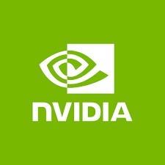

Risks - Continued
Capital-spend / ROI risk — huge 2025 capex increase may pressure returns:
Alphabet materially raised 2025 capex (management reaffirmed ~$75B then hiked to ~$85B) to scale AI/data-center's — investors worry about the timing and payback of that spending.
AI-hardware supply & export-control risk — GPU shortages & export rules can constrain AI rollouts:
Ongoing Nvidia/packaging supply bottlenecks and tighter U.S. export controls on advanced AI chips create the risk that GCP and Gemini scale more slowly or at a higher cost.
China regulatory/geopolitical risk — probes & trade measures could affect operations & supply chains:
China’s regulators opened probes, and broader trade/tariff tensions have led to retaliatory measures this year — geopolitical escalation could hit supply chains, partnerships, or ad/partner revenues.
Waymo / Other-Bets cash-burn & operational/regulatory setbacks:
Waymo continues to burn cash, has faced regulatory/recall actions (e.g., a recall of ~1,200 vehicles), and requires substantial funding/scale — failures or large incremental losses could negatively impact EPS and investor sentiment.

Slide 13
Investment Conclusion
Buy/Hold
BUY — Target $235.44 with upside of 10.58% — AI, Cloud & YouTube monetization support sustainable upside.
Why now? — Gemini commercial rollouts + improving Cloud margins are beginning to convert into measurable revenue and operating leverage; catalysts expected over next 12 months. Ad recovery signs and product monetization changes (SGE ad tests) justify entering before broader market repricing.
Top drivers: AI monetization; YouTube monetization; Cloud margin expansion.
Top risks: Regulatory remedies; AI/cloud competition; elevated capex.
Investor action: Consider staged buy; monitor quarterly monetization metrics and regulatory developments.
Our View:
Summing up — we recommend BUY/HOLD on Alphabet. Our blended DCF/comps target is $235.44, implying a 10.58% Upside from today’s price of $212.91. Why now? Gemini commercialization and improving Google Cloud margins are reaching inflection points and should start converting into sustainable revenue and operating leverage over the next 12–24 months. Main risks are regulatory remedies and AI/cloud competition — we monitor the court/regulatory calendar and quarterly guidance for execution signals. In short: upside is catalyst-driven and supported by cash generation; downside is primarily regulatory/execution — see our sensitivity and risk pages for detail.

